Slide 1
COGNITION

Slide 2
Cognition
A general term including all mental processes by which people become aware of and understand the world.
Cognition literally means “knowing”
If we want to know what makes people think then we need to understand the internal processes of their mind
Reductionist approach: Behaviour, no matter how complex can be reduced to simple cognitive processes, like memory or perception.

Slide 3
Cognition Involves Reducing Sensory Information
Bottom Up vs. Top Down Approach
Cognition Involves Elaborating Information
Cognition Involves Storing and Recovering Information
Cognition Involves Using Information
COGNITIVE ABILITIES ARE NOT FIXED — WE CAN IMPROVE THEM VIA LIFESTYLE AND TARGETED PRACTICE

Slide 4
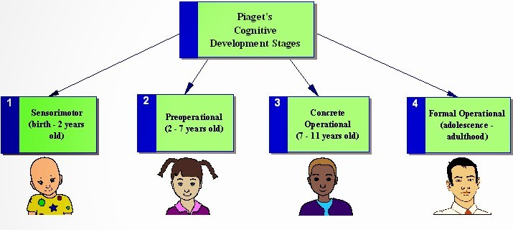
Piaget’s Stages of Cognitive Development

Slide 5
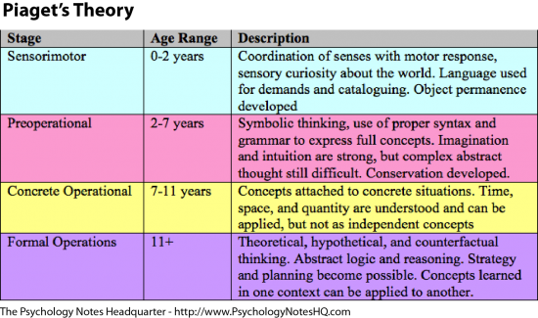

Slide 6
Knowing the Knowledge: Schema
Humans are active and motivated learners.
Through their action, they construct schemas.
Concepts or mental frameworks that people use to organize and interpret information
A person’s “picture of the world”

Slide 7
Development of Schemas
Schemas are frameworks that develop to help organize knowledge
Assimilation—process of taking new information or a new experience and fitting it into an already existing schema
Accommodation—process by which existing schemas are changed or new schemas are created in order to fit new information

Slide 8
Assimilation
Interpreting a new experience within the context of one’s existing schemas
The new experience is similar to other previous experiences

Slide 9
Accommodation
Interpreting a new experience by adapting or changing one’s existing schemas
The new experience is so novel the person’s schemata must be changed to accommodate it

Slide 10
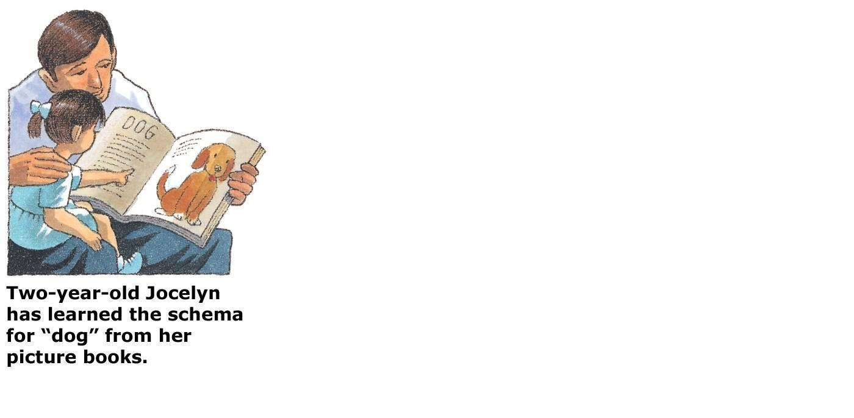
Assimilation/Accommodation

Slide 11
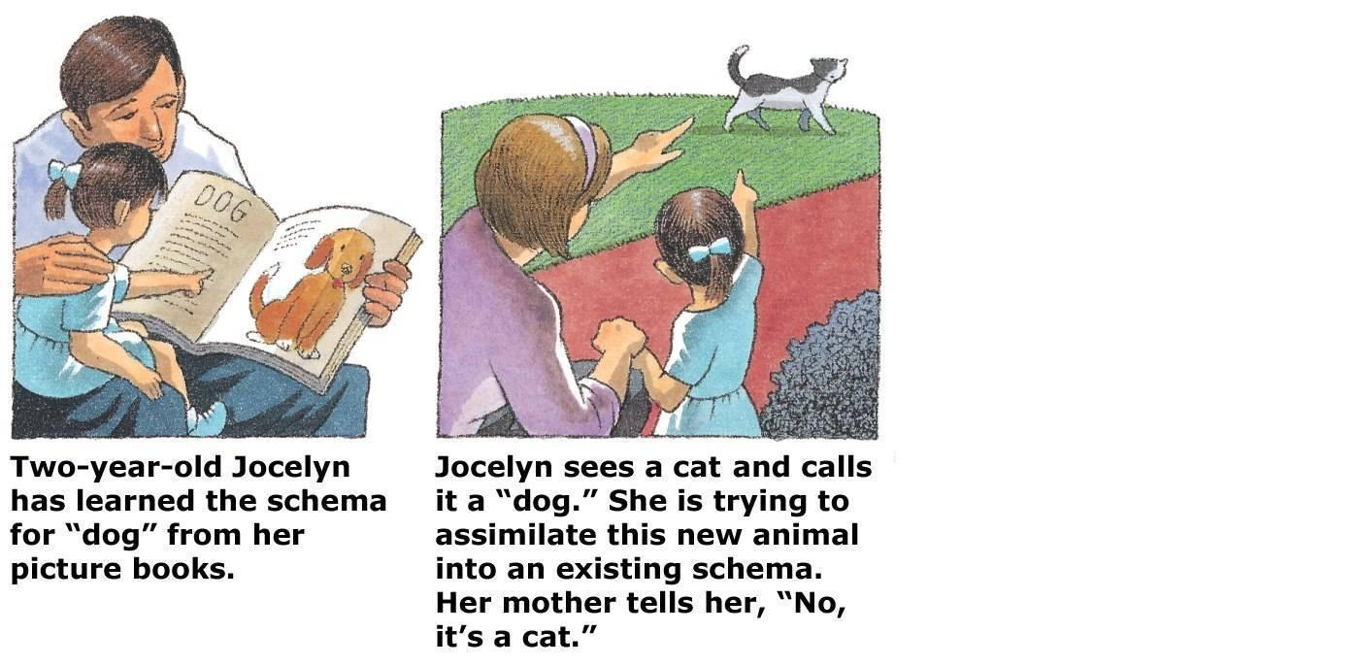
Assimilation/Accommodation

Slide 12
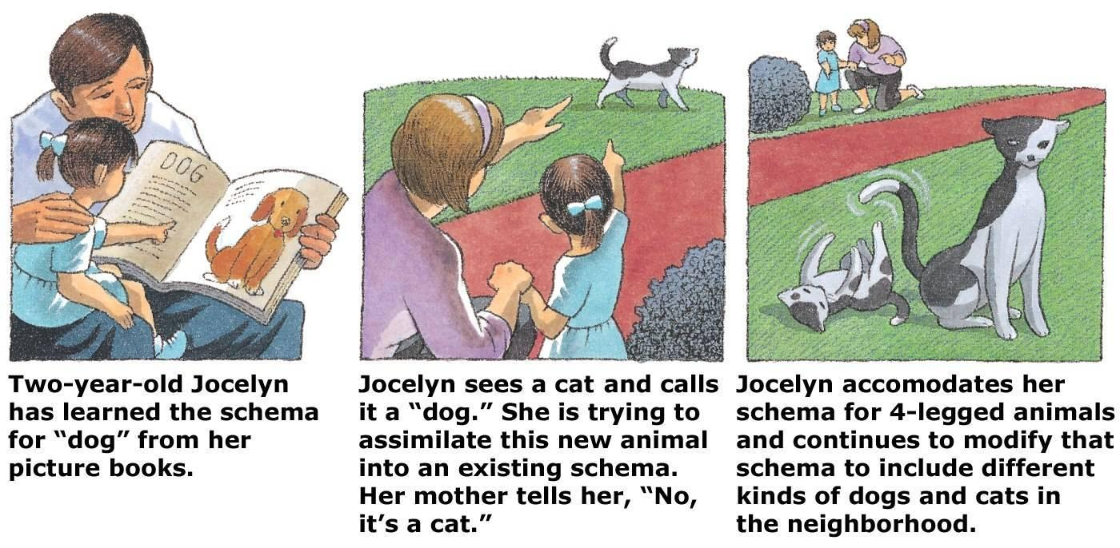
Assimilation/Accommodation
As children assimilate new information and experiences, they eventually change their way of thinking to accommodate new knowledge

Slide 13
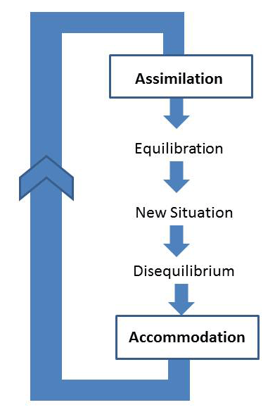
Knowing the Knowledge: Schema

Slide 14
Some facts about cognition:
Cognitive skills are different from academic skills
Cognitive skills are the mental capabilities or underlying skills you need to process and learn information, to think, remember, read, understand and solve problems.
Cognitive skills develop and change over time.
We are born with certain cognitive capabilities - we may be better at some skills than others, but we can improve the weaker skills.

Slide 15
Cognitive skills can be measured.
Cognitive skills can be strengthened and improved.
When cognitive skills are strong, learning becomes easier and vice versa

Slide 16
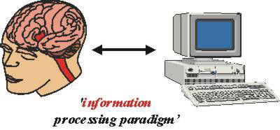
Computer Analogy
The use of the computer as a tool for thinking how the human mind handles information is known as the computer analogy
Essentially, a computer codes (i.e. changes) information, stores information, uses information, and produces an output (retrieves info)

Slide 17
Information Processing Approach
Assumptions:
Information made available from the environment is processed by a series of processing systems (e.g. attention, perception, short-term memory);
These processing systems transform, or alter the information in systematic ways;
Information processing in humans resembles that in computers.

Slide 18
“EVERY MAN” is in certain respects:
like all other men,
b. like some other men,
c. like no other man.
Henry A. Murray and Clyde Kluckhohn, Personality in Nature, Society, and Culture (1953)

